Slide 1
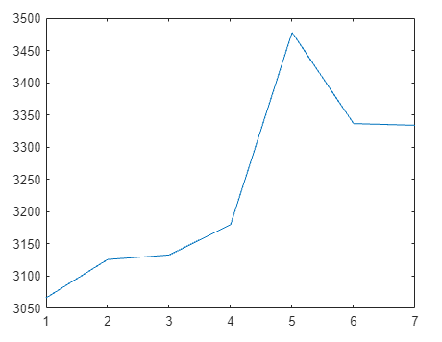
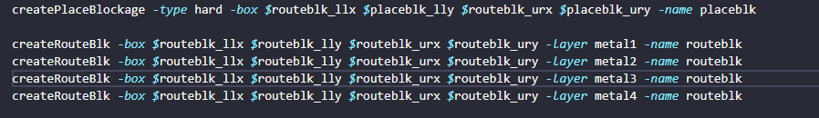
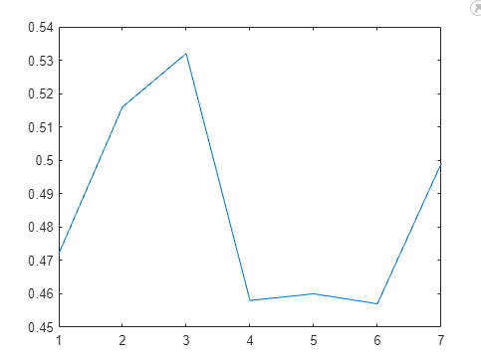
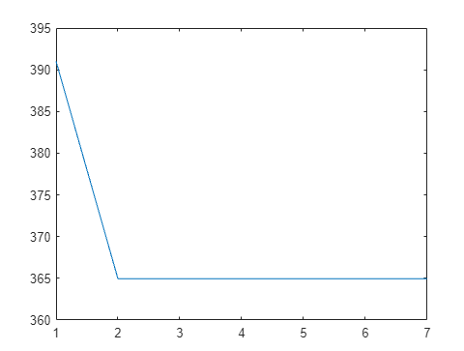
Justin La
MidTerm Project Report
Wirelength(um)
Command: Route and Placement Blockages
Test #7 (route blk on layer 1 2 3 4 failed with DRC errors
Connecting Instances placed on opposite sides route blockage have nowhere to metal layer to route, because all available layers are blocked.
Slack(ns)
Standard Cell Area (um^2)

